Slide 1
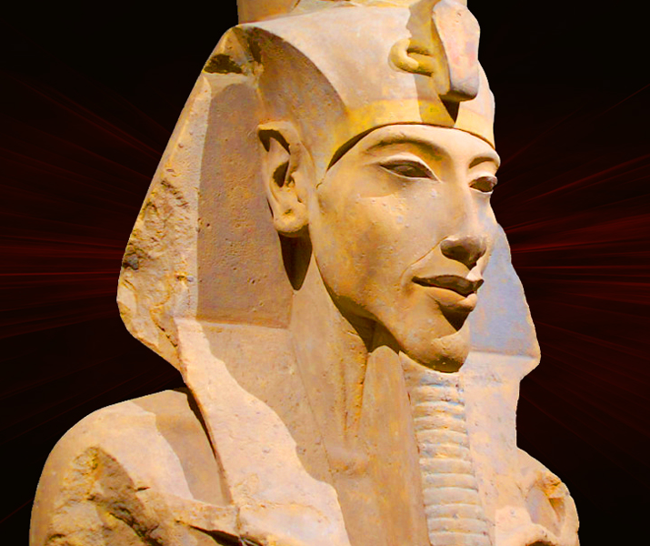
Re-Horahkty
GOAL/S: Outline the significance of Akhenaten's introduction of the solar god Re-Horakhty
Week 10, Lesson 2

Slide 2
Key Terms:
Akhenaten
Re-Horakhty
Aten
Syncretic

Slide 3
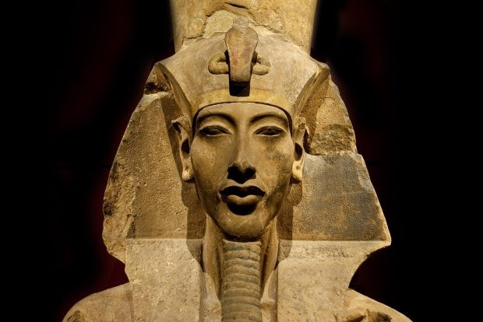
REVIEW - Akhenaten
KEY TERM
Also known as Amenhotep IV, Akhenaten was a pharaoh of the 18th dynasty of Egypt. He ruled from approximately 1353 BCE to 1336 BCE. Akhenaten is notable for his religious revolution, during which he promoted the worship of a single god, Aten, and suppressed other deities. His reign marked a departure from traditional Egyptian polytheism.
PRONOUNCED: ah-ken-AH-ten
Notes:
IV = 4

Slide 4
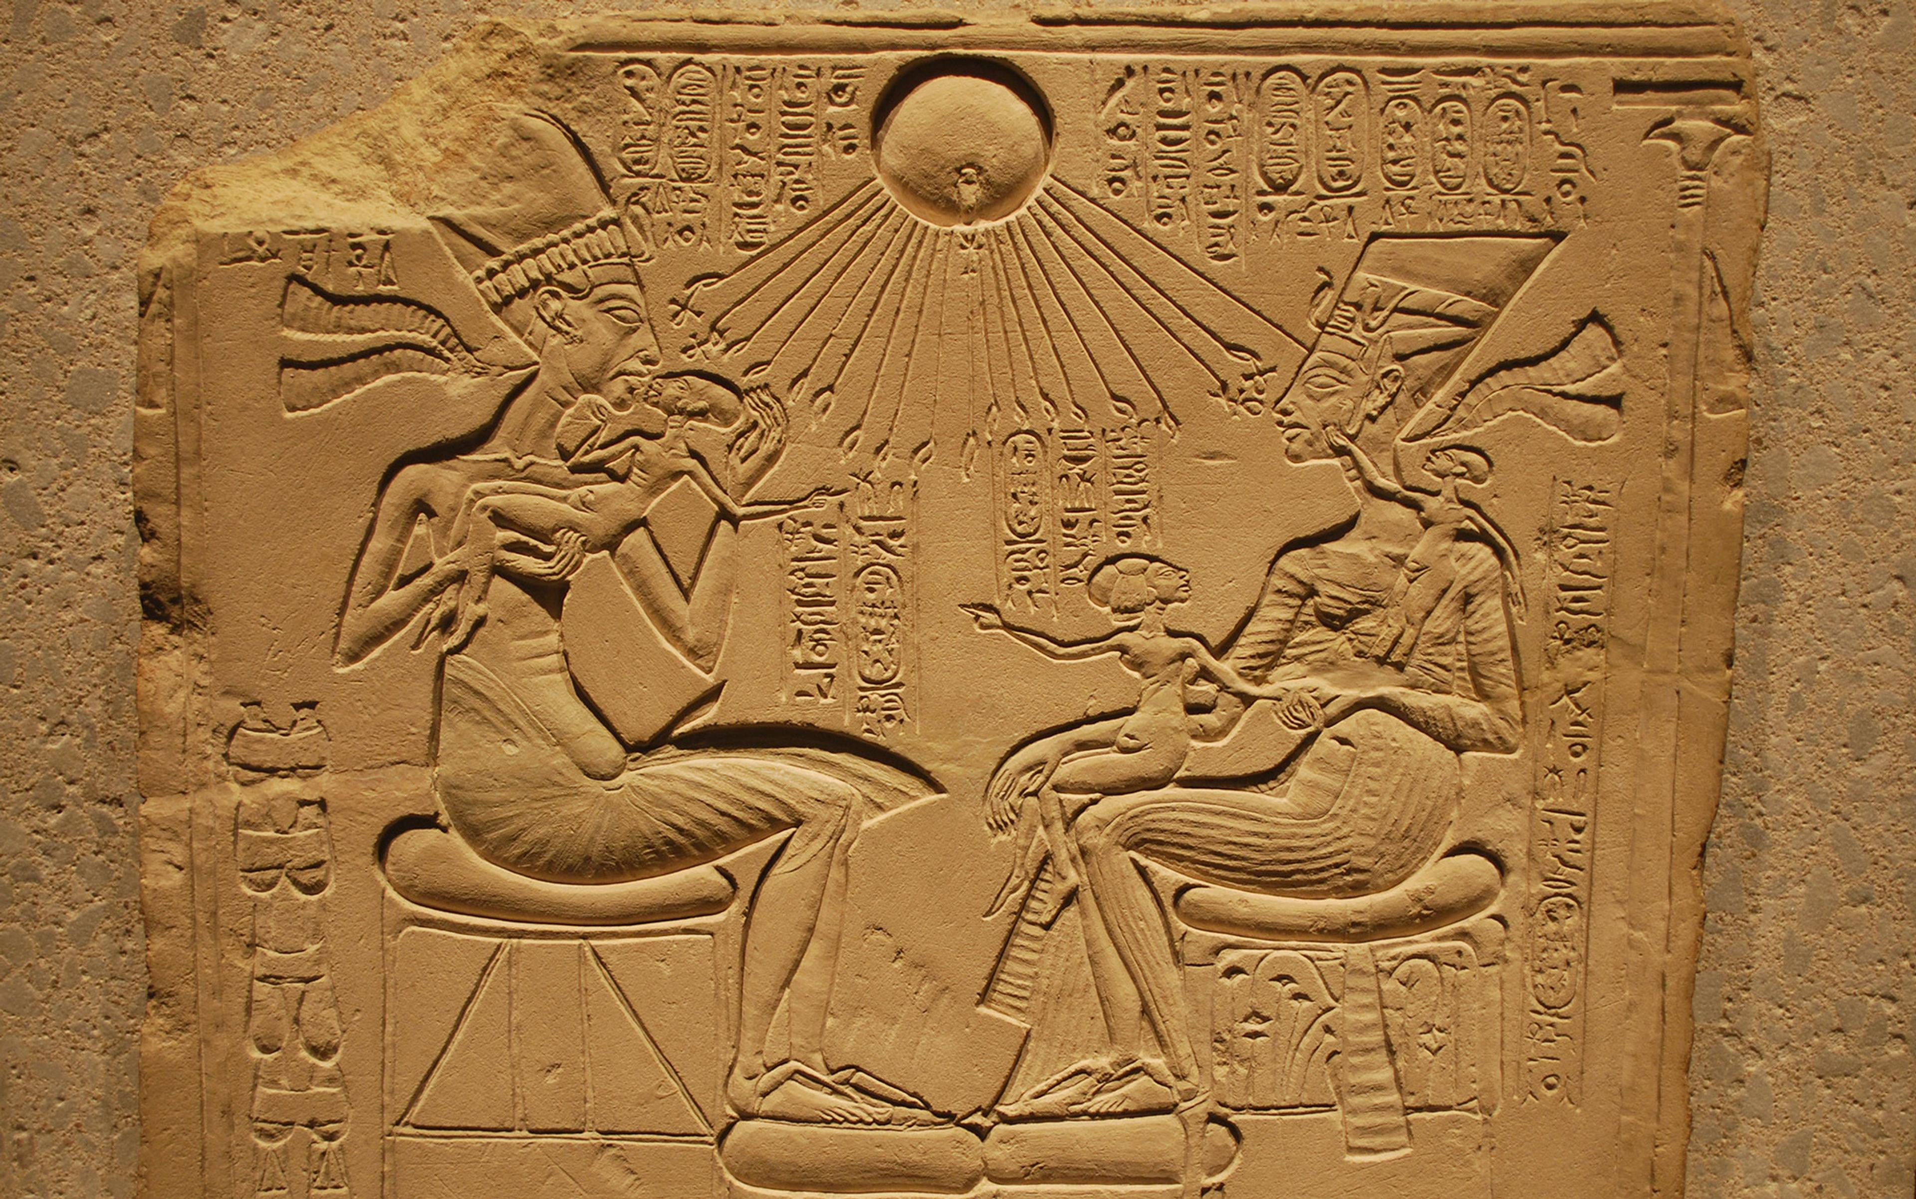
Re-Horakhty
KEY TERM
Initially a deity within the Egyptian pantheon associated with the sun, later elevated by Akhenaten to supreme status and renamed Aten.
PRONOUNCED: Ray-HOR-ahk-tee
Notes:
IV = 4

Slide 5

Aten
KEY TERM
The sun god worshipped by Akhenaten as the sole deity, depicted as a sun disk emitting rays with hands.
PRONOUNCED: AH-ten
Notes:
IV = 4

Slide 6
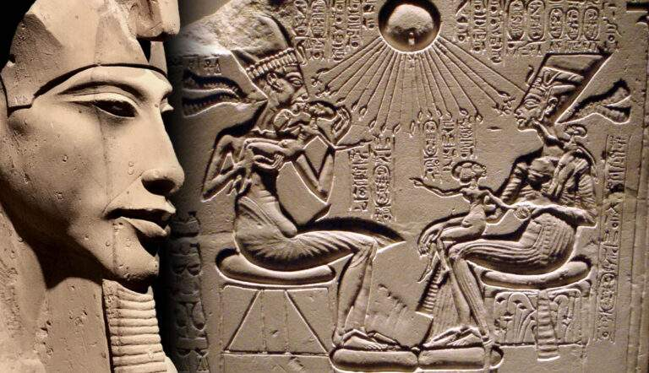
Syncretic
KEY TERM
characterized or brought about by a combination of different forms of belief or practice
WRITE THIS DOWN
Notes:
IV = 4

Slide 7
Akhenaten's religious reforms, centered around the worship of the Aten, did not entirely reject the traditional Egyptian gods but rather attempted to syncretize them with the Aten, creating a form of henotheism where the Aten was elevated above other gods while still acknowledging their existence. This syncretism allowed Akhenaten to maintain elements of traditional religious beliefs while promoting the Aten as the supreme deity.
Notes:
Henotheism: adherence to one particular god out of several, especially by a family, tribe, or other group.

Slide 8
Introduction of Re-Horakhty
Re-Horakhty, "Ra-Horus of the Horizons," was initially part of the traditional Egyptian pantheon.
Akhenaten elevated Re-Horakhty to supreme status, renaming him Aten.
Aten depicted as a sun disk emitting rays ending in hands.
Monotheistic shift, Aten became the central deity.
Decline in worship of other gods, including Amun.

Slide 9
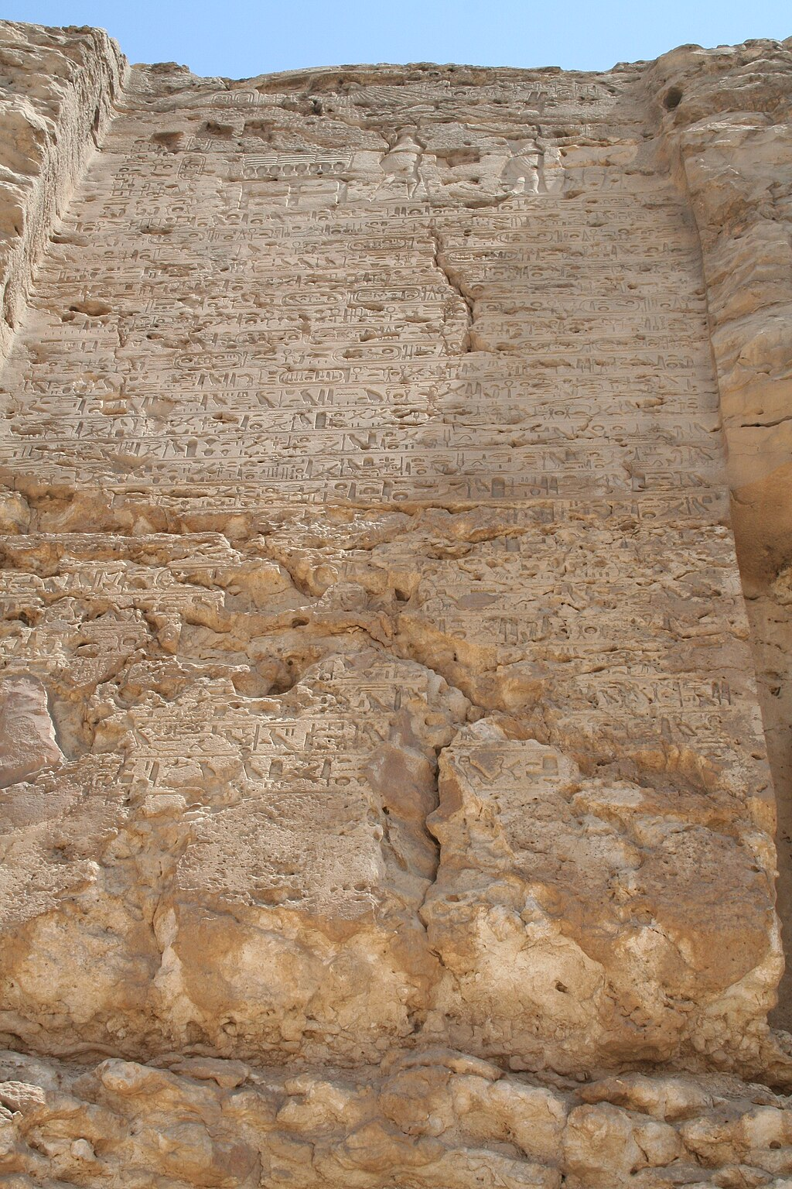
Depictions
In some artistic representations, particularly during the early years of Akhenaten's reign, the Aten was depicted alongside other gods, such as Amun-Ra and Horus. For example, in the boundary stelae found at the temple of Karnak, the Aten is depicted with other gods, including Amun-Ra. These stelae served as markers delineating the boundaries of the Aten's influence.

Slide 10
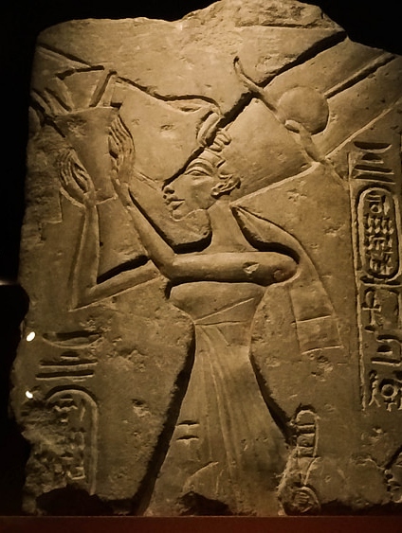
Depictions
Artifacts from Akhenaten's reign often show the Aten symbolically represented as a sun disc with rays extending downward, each ending in a hand holding an ankh, the symbol of life.Sometimes, these rays terminate in hands holding cartouches with the names of Akhenaten and his wife, Nefertiti, suggesting their divine connection to the Aten.
Notes:
Nefertiti offering to Aten

Slide 11
Depictions
Some depictions show syncretic forms where traditional gods are assimilated into the imagery of the Aten.
For example, Amun-Ra might be depicted as one of the hands extending from the Aten, symbolizing the incorporation of Amun-Ra's attributes into the Aten's divine nature.

Slide 12
ACTIVITY – Essay Plan
Based on today’s lesson, choose ONE (1) of the following questions to create an ESSAY PLAN for.
Use the template provided:
QUESTION 1: Describe the causes and impacts of Akhenaten’s early religious changes.
OR
QUESTION 2: Describe how the introduction of a new primary deity affected Egyptian society.

